Slide 1
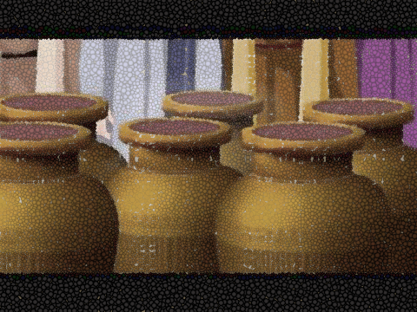
A Special Wedding
John 2:1-11

Slide 2
A Special Wedding
John 2:1-11
Precise chronology

Slide 3
A Special Wedding
John 2:1-11
Precise chronology
Old New

Slide 4
A Special Wedding
John 2:1-11
Precise chronology
Old New
Book of signs

Slide 5
A Special Wedding
John 2:1-11
Precise chronology
Old New
Book of signs
Leon Morris: “Jesus changing the water of Judaism into the wine of Christianity”

Slide 6
A Special Wedding
John 2:1-11
1. The situation On the third day a wedding took place at Cana in Galilee. Jesus’ mother was there, and Jesus and his disciples had also been invited to the wedding.

Slide 7
A Special Wedding
John 2:1-11
The situation
Double meaning: “the third day”

Slide 8
A Special Wedding
John 2:1-11
The situation
Double meaning: “the third day”
Mary’s connection

Slide 9
A Special Wedding
John 2:1-11
The situation
Double meaning: “the third day”
Mary’s connection
Jewish weddings

Slide 10
A Special Wedding
John 2:1-11
The situation
Double meaning: “the third day”
Mary’s connection
Jewish weddings
Guest lists

Slide 11
A Special Wedding
John 2:1-11
The situation
The sign When the wine was gone, Jesus’ mother said to him, ‘They have no more wine.’ ‘Woman, why do you involve me?’ Jesus replied. ‘My hour has not yet come.’ His mother said to the servants, ‘Do whatever he tells you.’ Nearby stood six stone water jars, the kind used by the Jews for ceremonial washing, each holding from eighty to a hundred and twenty litres. Jesus said to the servants, ‘Fill the jars with water’; so they filled them to the brim. Then he told them, ‘Now draw some out and take it to the master of the banquet.’

Slide 12
A Special Wedding
John 2:1-11
The situation
The sign They did so, and the master of the banquet tasted the water that had been turned into wine. He did not realise where it had come from, though the servants who had drawn the water knew. Then he called the bridegroom aside and said, ‘Everyone brings out the choice wine first and then the cheaper wine after the guests have had too much to drink; but you have saved the best till now.’

Slide 13
A Special Wedding
John 2:1-11
The situation
The sign
Mary’s intervention

Slide 14
A Special Wedding
John 2:1-11
The situation
The sign
Mary’s intervention
Jesus’ reply “Woman, why do you involve me? My hour has not yet come.”

Slide 15
A Special Wedding
John 2:1-11
The situation
The sign
Mary’s intervention
Jesus’ reply
No disrespect intended – see 19:26; 20:15

Slide 16
A Special Wedding
John 2:1-11
The situation
The sign
Mary’s intervention
Jesus’ reply
No disrespect intended – see 19:26; 20:15
Modern expression: “you must not tell me what to do” (GNT)

Slide 17
A Special Wedding
John 2:1-11
The situation
The sign
Mary’s intervention
Jesus’ reply
No disrespect intended – see 19:26; 20:15
Modern expression: “you must not tell me what to do” (GNT)
Jesus’ reasons

Slide 18
A Special Wedding
John 2:1-11
The situation
The sign
Mary’s intervention
Jesus’ reply
Mary’s reaction - His mother said to the servants, ‘Do whatever he tells you.’

Slide 19
A Special Wedding
John 2:1-11
The situation
The sign
Mary’s intervention
Jesus’ reply
Mary’s reaction
Jesus’ response

Slide 20
A Special Wedding
John 2:1-11
The situation
The sign
Mary’s intervention
Jesus’ reply
Mary’s reaction
Jesus’ response
Jesus’ instructions
Nearby stood six stone water jars, the kind used by the Jews for ceremonial washing, each holding from eighty to a hundred and twenty litres. Jesus said to the servants, ‘Fill the jars with water’; so they filled them to the brim. Then he told them, ‘Now draw some out and take it to the master of the banquet. They did so.

Slide 21
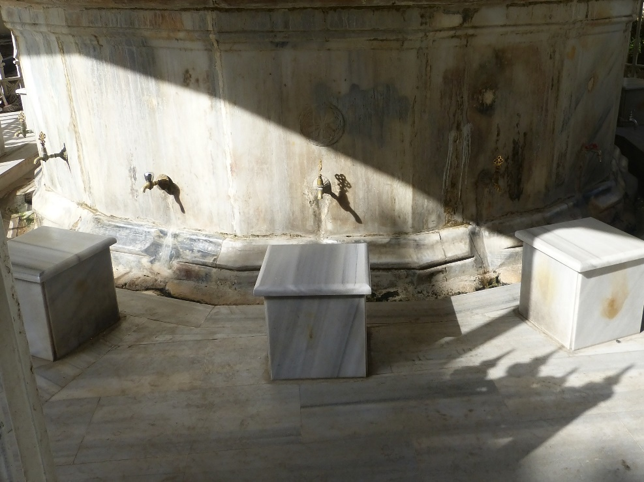
A Special Wedding
John 2:1-11
The situation
The sign
Mary’s intervention
Jesus’ reply
Mary’s reaction
Jesus’ response
Jesus’ instructions
Purification rituals

Slide 22
A Special Wedding
John 2:1-11
The situation
The sign
Mary’s intervention
Jesus’ reply
Mary’s reaction
Jesus’ response
Jesus’ instructions
Purification rituals
Outward only

Slide 23
A Special Wedding
John 2:1-11
The situation
The sign
Mary’s intervention
Jesus’ reply
Mary’s reaction
Jesus’ response
Jesus’ instructions
Headwaiter’s appraisal- “Everyone brings out the choice wine first and then the cheaper wine after the guests have had too much to drink, but you have saved the best till now.”

Slide 24
A Special Wedding
John 2:1-11
The situation
The sign
Mary’s intervention
Jesus’ reply
Mary’s reaction
Jesus’ response
Jesus’ instructions
Headwaiter’s appraisal
Past objections

Slide 25
A Special Wedding
John 2:1-11
The situation
The sign
Mary’s intervention
Jesus’ reply
Mary’s reaction
Jesus’ response
Jesus’ instructions
Headwaiter’s appraisal
Past objections
World view

Slide 26
A Special Wedding
John 2:1-11
The situation
The sign
The significance – new order

Slide 27
A Special Wedding
John 2:1-11
The situation
The sign
The significance
4. The splendour This, the first of his miraculous signs, Jesus performed in Cana of Galilee. He thus revealed his glory, and his disciples put their faith in him. After this he went down to Capernaum with his mother and brothers and his disciples. There they stayed for a few days.

Slide 28
A Special Wedding
John 2:1-11
The situation
The sign
The significance
The splendour
Breakdown between sacred and secular

Slide 29
A Special Wedding
John 2:1-11
The situation
The sign
The significance
The splendour
Breakdown between sacred and secular
Passage from old to new - “dying to what once bound us, we have been released from the law so that we serve in the new way of the Spirit, and not in the old way of the written code” (Rom.7:6).

Slide 30
A Special Wedding
John 2:1-11
The situation
The sign
The significance
The splendour
Conclusion:
Water of tradition or joyous wine of Spirit?

Slide 31
A Special Wedding
John 2:1-11
The situation
The sign
The significance
The splendour
Conclusion:
Water of tradition or joyous wine of Spirit?
What about the sad?

Slide 32
A Special Wedding
John 2:1-11
The situation
The sign
The significance
The splendour
Conclusion:
Water of tradition or joyous wine of Spirit?
What about the sad?
Transforming power of Jesus

